Slide 1
CS6811 – PROJECT WORK A SECURE CLOUD DEDUPLICATION FRAMEWORK WITH BEHAVIOURAL MONITORING DOMAIN: SECURE STORAGE SYSTEMS, DEDUPLICATION, CLOUD SECURITY
TEAM MEMBERS
Shruthikaa.S Lahari.V Ajay.C.S | 2022503555 2022503559 2022503557
SUPERVISOR
Dr. Kathiroli R

Slide 2
INTRODUCTION
Cloud computing has driven massive data growth from social media, enterprise systems, and IoT, making data deduplication essential for achieving 50–80% storage savings. Chunk-level deduplication uses SHA-256 hashing to detect duplicates and store references instead of redundant data.
However, deterministic hashing introduces security risks in multi-tenant environments, including file existence inference, hash probing, timing attacks, ownership fraud, and deduplication-based DoS attacks.
Existing solutions lack a unified approach combining storage efficiency, security verification, and runtime monitoring.
This project proposes a Secure Cloud Deduplication Framework with Behavioural Monitoring, extending REFA (Wu et al., 2024) using:
HMAC-SHA256 + Ristretto255 OPRF for secure key derivation
Adaptive Proof-of-Ownership + ML detection (RF + OCSVM)
HKDF + AES-256-GCM encryption with behavioural monitoring
The framework achieves 65–80% storage reduction and reduces attacker success rate by 45.49% through adaptive security controls.

Slide 3
PROBLEM STATEMENT
Traditional deduplication systems focus primarily on storage efficiency, often treating security as a secondary concern. The server’s response to hash queries can unintentionally reveal whether data already exists, creating a side-channel vulnerability for attackers.
This design leads to several well-known attack vectors:
Hash Probing: Attackers query known hashes to infer stored content
Side-Channel Attacks: Timing differences expose duplicate vs. unique data
Ownership Fraud: Claiming file ownership without actually possessing the data
Deduplication DoS: Flooding the system with duplicate requests to exhaust resources
These challenges highlight that deduplication introduces a security-sensitive protocol layer, not just a storage optimization technique.
Existing solutions like static Proof-of-Ownership (PoW) and network-level IDS address threats in isolation, but lack integrated runtime behavioral monitoring at the deduplication level.
This project proposes a unified cryptographic and behavioral framework, treating secure deduplication as a combined systems, security, and behavioral problem.

Slide 4
LITERATURE SURVEY
S. No | Title | Journal / Year | Proposed Work | Limitations
1 | A Review on Secure Data Deduplication: Cloud Storage Security Issue | Journal of King Saud University – Computer and Information Sciences, 2022 | • Surveys secure cloud deduplication techniques and threat models. • Analyzes trade-offs between security, storage efficiency, and performance. | • Review-only paper without implementation. • No experimental prototype or deployable framework.
2 | Decentralized and Secure Deduplication with Dynamic Ownership in MLaaS | Journal of Information Security and Applications, 2023 | • Proposes decentralized deduplication with dynamic ownership updates. • Enhances secure model sharing in MLaaS environments. | • Focused on MLaaS context, not general cloud storage. • Lacks runtime behavioral attack detection.
3 | A Secure and Efficient Data Deduplication Scheme with Dynamic Ownership Management in Cloud Computing | IPCCC, 2022 | • Introduces hybrid-cloud encrypted deduplication. • Supports dynamic ownership verification and access control. | • No adaptive risk-based monitoring mechanism. No machine-learning or deep learning methods used.

Slide 5
LITERATURE SURVEY
S. No | Title | Journal / Year | Proposed Work | Limitations
4 | Privacy and Accuracy-Aware AI/ML Model Deduplication | Proceedings of the ACM on Management of Data (SIGMOD), 2025 | • Studies deduplication of AI/ML models under privacy constraints. • Balances accuracy preservation with storage reduction. | • Focused on ML model deduplication. • Not designed for secure file/chunk-level cloud storage.
5 | Secure and Efficient Deduplication for Cloud Storage with Dynamic Ownership Management | Applied Sciences, 2023 | • Implements secure encrypted deduplication with ownership updates. • Improves storage efficiency while maintaining confidentiality. | • Assumes trusted cryptographic components. • Limited runtime behavioral defense.
6 | DIADD: Secure Deduplication and Efficient Data Integrity Auditing With Data Dynamics for Cloud Storage | IEEE Transactions on Network and Service Management, 2025 | • Integrates deduplication with dynamic data integrity auditing. • Supports secure updates and data modifications. | • Strong focus on auditing over attack mitigation. • No behaviour-driven adaptive control mechanism.

Slide 6
LITERATURE SURVEY
S. No | Title | Journal / Year | Proposed Work | Limitations
7 | Enabling Secure Auditing and Deduplication in Multi-Replica Cloud Storage | IEEE Transactions on Dependable and Secure Computing, 2025 | • Combines secure deduplication with auditing in multi-replica systems. • Enhances reliability and data verification. | • Multi-replica specific design complexity. • Does not address behavioral attack detection.
8 | Secure Deduplication and Cloud Storage Auditing With Efficient Dynamic Ownership Management and Data Dynamics | IEEE Transactions on Network and Service Management, 2025 | • Provides end-to-end secure deduplication with auditing. • Supports dynamic ownership and data updates. | • Protocol-heavy and complex implementation. • No adaptive PoW or risk-based throttling.
9 | A Lightweight Encrypted Deduplication Scheme Supporting Backup | Journal of Systems Architecture, 2023 | • Designs lightweight encrypted deduplication for backup workloads. • Reduces storage overhead in backup systems. | • Backup-centric scope. • Limited ownership and adversarial runtime protection.

Slide 7
LITERATURE SURVEY
S. No | Title | Journal / Year | Proposed Work | Limitations
10 | A Secure Client-Side Deduplication Scheme Based on Updatable Server-Aided Encryption | IEEE Transactions on Cloud Computing, 2023 | • Proposes client-side encrypted deduplication with server-aided encryption. • Incorporates secure Proof-of-Ownership verification. | • Strong dependency on server-aided encryption. • Lacks system-level behavioral monitoring.
11 | ADD-QIA: An Adaptive Data Deduplication Framework | Research Gate,2022 | • Introduces adaptive optimization-based deduplication framework. • Adjusts deduplication policies dynamically. | • No behaviour monitoring • No detailed security attack modeling.
12 | FuzzyDedup: Secure Fuzzy Deduplication for Cloud Storage | IEEE Transactions on Dependable and Secure Computing, 2023 | • Enables similarity-aware encrypted deduplication. • Improves storage efficiency for near-duplicate files. | • High computational and indexing complexity. • Similarity thresholds may cause operational trade-offs.

Slide 8
LITERATURE SURVEY
S. No | Title | Journal / Year | Proposed Work | Limitations
13 | Leveraging Data Deduplication Approaches in the Cloud Storage: A Succinct Review | Procedia Computer Science, 2025 | • Summarizes modern deduplication strategies and techniques. • Discusses design considerations in cloud environments. | • Review-only article. • No implementation or experimental validation.
14 | LSDedup: Layered Secure Deduplication for Cloud Storage | IEEE Transactions on Computers, 2024 | • Proposes layered encryption-based deduplication architecture. • Balances confidentiality with storage efficiency. | • Increased architectural complexity. • No adaptive runtime risk control.
15 | Similarity-Based Secure Deduplication for IIoT Cloud Management System | IEEE Transactions on Dependable and Secure Computing, 2024 | • Applies similarity-based secure deduplication in IIoT systems. • Improves deduplication ratio for industrial cloud data. | • Domain-specific to IIoT environments. • Limited applicability to general enterprise cloud storage.

Slide 9
OBJECTIVES
To analyse security vulnerabilities in cloud data deduplication and characterise attack models (hash probing, side-channel, ownership fraud, deduplication DoS)
To implement HMAC-SHA256 secret-assisted token generation and HKDF-AES-256-GCM per-chunk encryption, eliminating the external key-server dependency of REFA
To design a telemetry and feature extraction pipeline capturing twelve request-level behavioural signals per client session in real time
To develop a supervised Random Forest classifier (120 estimators, depth 4) for multiclass attack attribution across four behavioural classes: normal, hash probing, ownership fraud, deduplication DoS
To develop an unsupervised One-Class SVM anomaly detection module for cold-start and zero-day attack scenarios
To implement an Adaptive PoW mechanism that calibrates challenge difficulty dynamically based on client risk score, reputation, and duplicate request pressure
To evaluate the integrated framework on 2200-window simulated stress-test dataset calibrated against Azure trace windows, reporting detection accuracy, storage efficiency, and system overhead

Slide 10
ARCHITECTURE DIAGRAM

Slide 11
INTERFACE MODULE
Single entry point for all client interactions; normalizes request semantics, enforces first-layer policy checks, and unifies security observability with storage functionality
Exposes a RESTful FastAPI (Uvicorn) with per-client API key authentication on every request
Three endpoints:
/upload → file ingestion with deduplication and PoW
/pow/challenge → adaptive challenge retrieval
/pow/verify → response verification
Retrieves active client policy from Redis policy store before any backend processing; supports ALLOW, RATE_LIMIT, and BLOCK decisions
Telemetry Logger captures every request event, creating both a storage action and an observation record for behavioural analysis:
Records timestamps, client ID, request type, chunk counts, and PoW results per request
Logs policy decisions; serves as synchronization point between user interaction, enforcement, and behavioural evidence collection
Stores data in CSV and SQLite for feature extraction

Slide 12
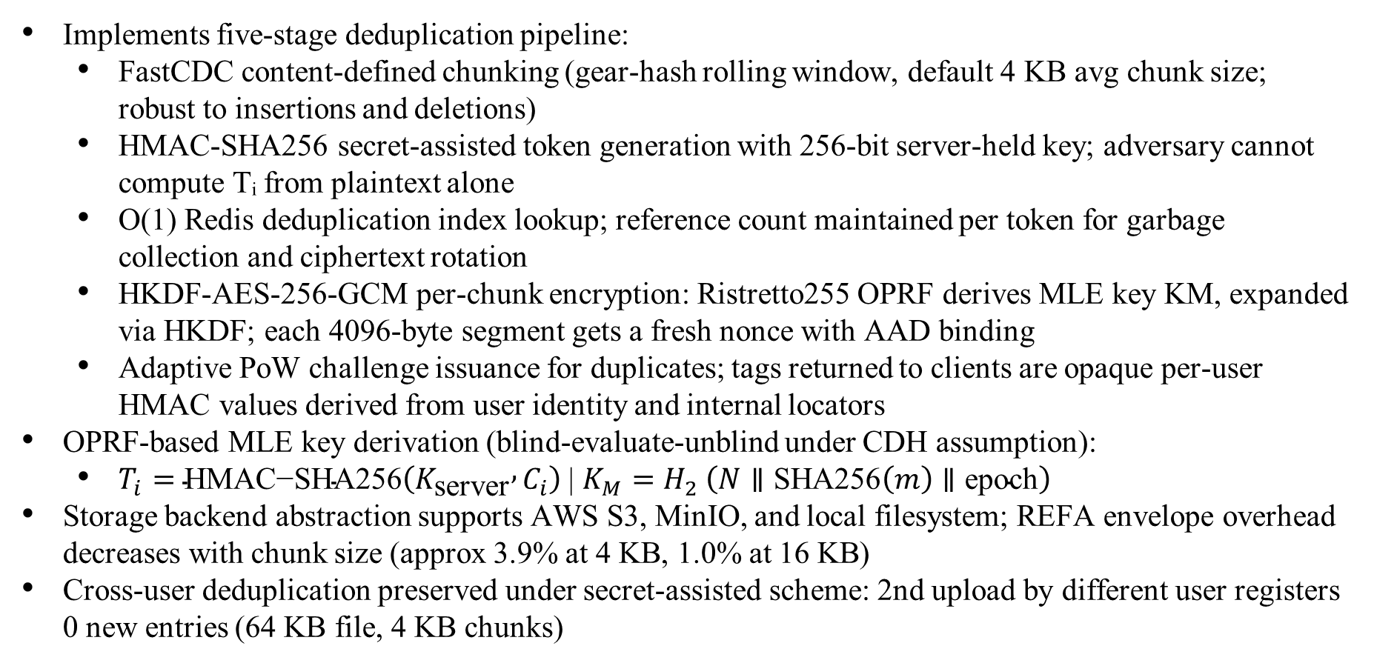
CORE DEDUPLICATION MODULE
Implements five-stage deduplication pipeline:
FastCDC content-defined chunking (gear-hash rolling window, default 4 KB avg chunk size; robust to insertions and deletions)
HMAC-SHA256 secret-assisted token generation with 256-bit server-held key; adversary cannot compute Tᵢ from plaintext alone
O(1) Redis deduplication index lookup; reference count maintained per token for garbage collection and ciphertext rotation
HKDF-AES-256-GCM per-chunk encryption: Ristretto255 OPRF derives MLE key KM, expanded via HKDF; each 4096-byte segment gets a fresh nonce with AAD binding
Adaptive PoW challenge issuance for duplicates; tags returned to clients are opaque per-user HMAC values derived from user identity and internal locators
OPRF-based MLE key derivation (blind-evaluate-unblind under CDH assumption):
$T_{i}=\text{HMAC}\text{−}\text{SHA}\text{256}\left(K_{\text{server}} , C_{i}\right)$| $K_{M}=H_{2} \left(N∥\text{SHA}\text{256}\left(m\right)∥\text{epoch}\right)$
Storage backend abstraction supports AWS S3, MinIO, and local filesystem; REFA envelope overhead decreases with chunk size (approx 3.9% at 4 KB, 1.0% at 16 KB)
Cross-user deduplication preserved under secret-assisted scheme: 2nd upload by different user registers 0 new entries (64 KB file, 4 KB chunks)

Slide 13
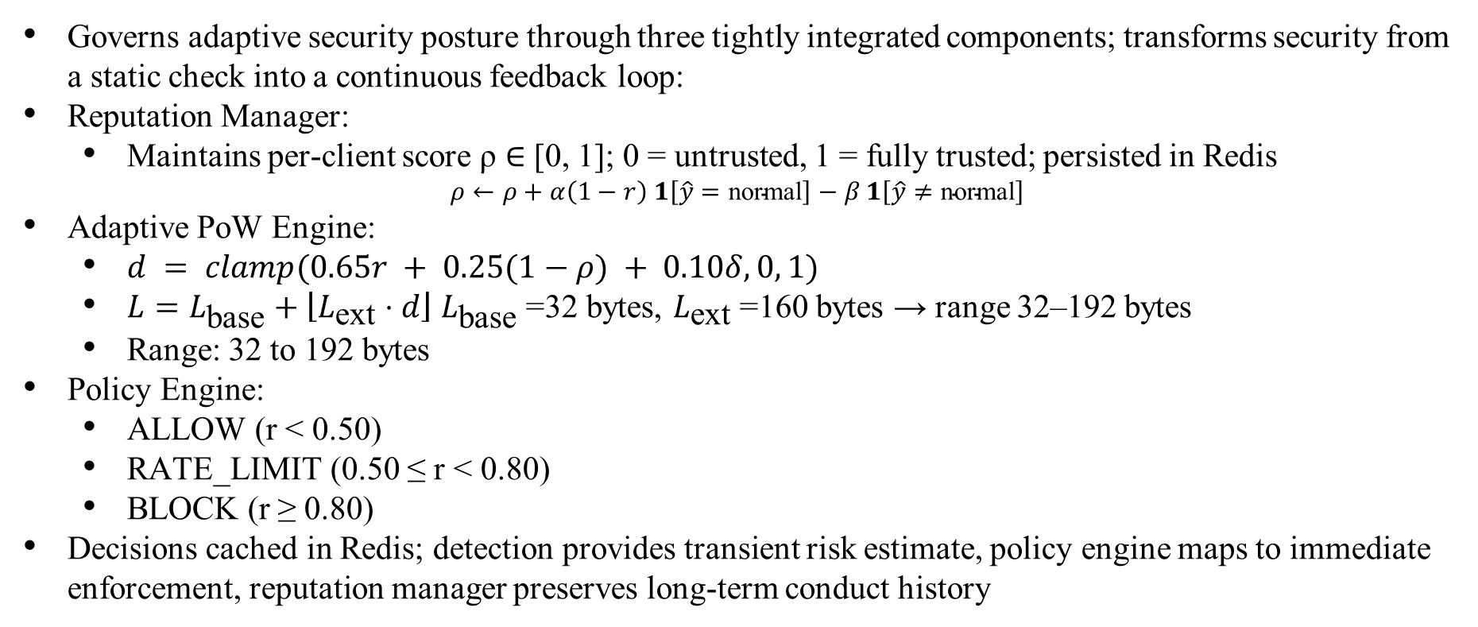
SECURITY AND CONTROL MODULE
Governs adaptive security posture through three tightly integrated components; transforms security from a static check into a continuous feedback loop:
Reputation Manager:
Maintains per-client score ρ ∈ [0, 1]; 0 = untrusted, 1 = fully trusted; persisted in Redis
$$ρ←ρ+α\left(1−r\right) 1\left[\hat{y}=\text{normal}\right]−β 1\left[\hat{y}≠\text{normal}\right]$$
Adaptive PoW Engine:
$d = clamp(0.65r + 0.25(1−ρ) + 0.10δ, 0, 1)$
$L=L_{\text{base}}+\left\lfloor L_{\text{ext}}⋅d\right\rfloor$ $L_{\text{base}}$=32 bytes, $L_{\text{ext}}$=160 bytes → range 32–192 bytes
Range: 32 to 192 bytes
Policy Engine:
ALLOW (r < 0.50)
RATE_LIMIT (0.50 ≤ r < 0.80)
BLOCK (r ≥ 0.80)
Decisions cached in Redis; detection provides transient risk estimate, policy engine maps to immediate enforcement, reputation manager preserves long-term conduct history

Slide 14
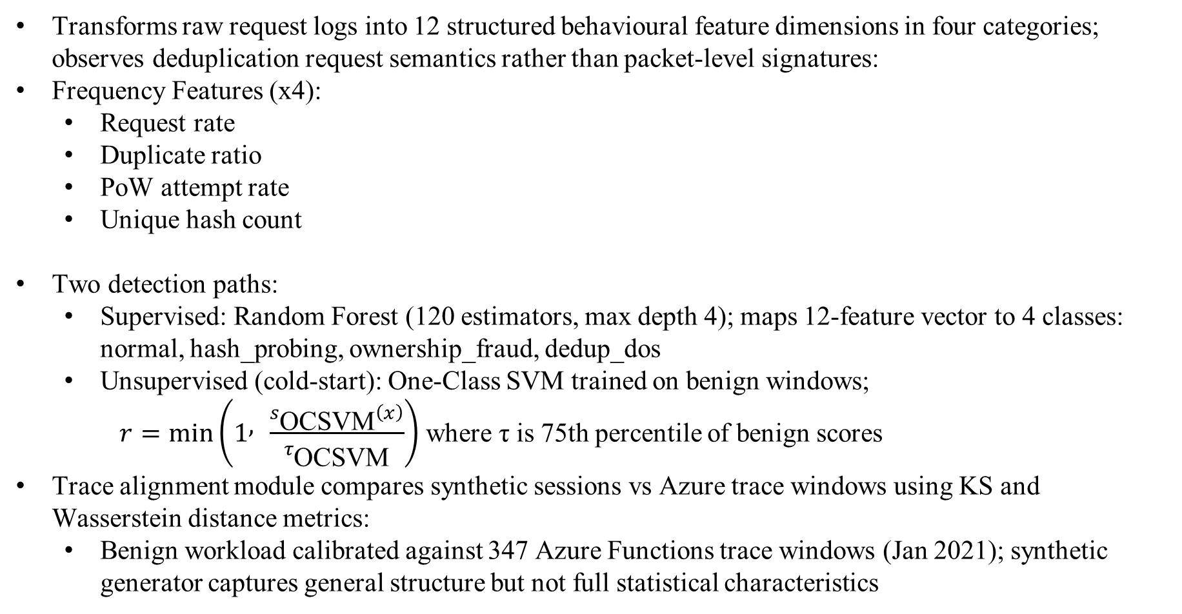
BEHAVIOUR DETECTION MODULE
Transforms raw request logs into 12 structured behavioural feature dimensions in four categories; observes deduplication request semantics rather than packet-level signatures:
Frequency Features (x4):
Request rate
Duplicate ratio
PoW attempt rate
Unique hash count
Two detection paths:
Supervised: Random Forest (120 estimators, max depth 4); maps 12-feature vector to 4 classes: normal, hash_probing, ownership_fraud, dedup_dos
Unsupervised (cold-start): One-Class SVM trained on benign windows;
$r=min⁡$⁡$\left(1 , \frac{s_{\text{OCSVM}}\left(x\right)}{τ_{\text{OCSVM}}}\right)$where τ is 75th percentile of benign scores
Trace alignment module compares synthetic sessions vs Azure trace windows using KS and Wasserstein distance metrics:
Benign workload calibrated against 347 Azure Functions trace windows (Jan 2021); synthetic generator captures general structure but not full statistical characteristics
Hash-Pattern Features (x4):
Hash diversity
Upload-to-query ratio
Cross-user overlap
Collision rate
Temporal Features (x4):
Inter-request variance
Burst score
Session duration
Requests per hour

Slide 15
ALGORITHM – Complete Flow
TEAM 44 - CS6811 - PROJECT WORK
15

Slide 16
ALGORITHM – Core Deduplication and Adaptive PoW

Slide 17
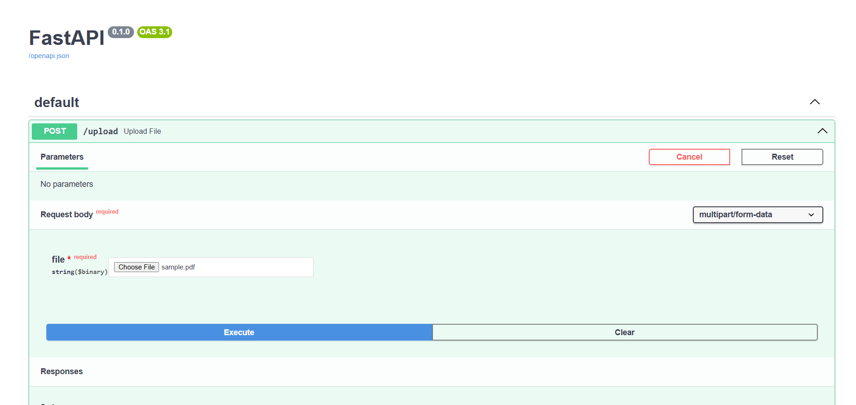
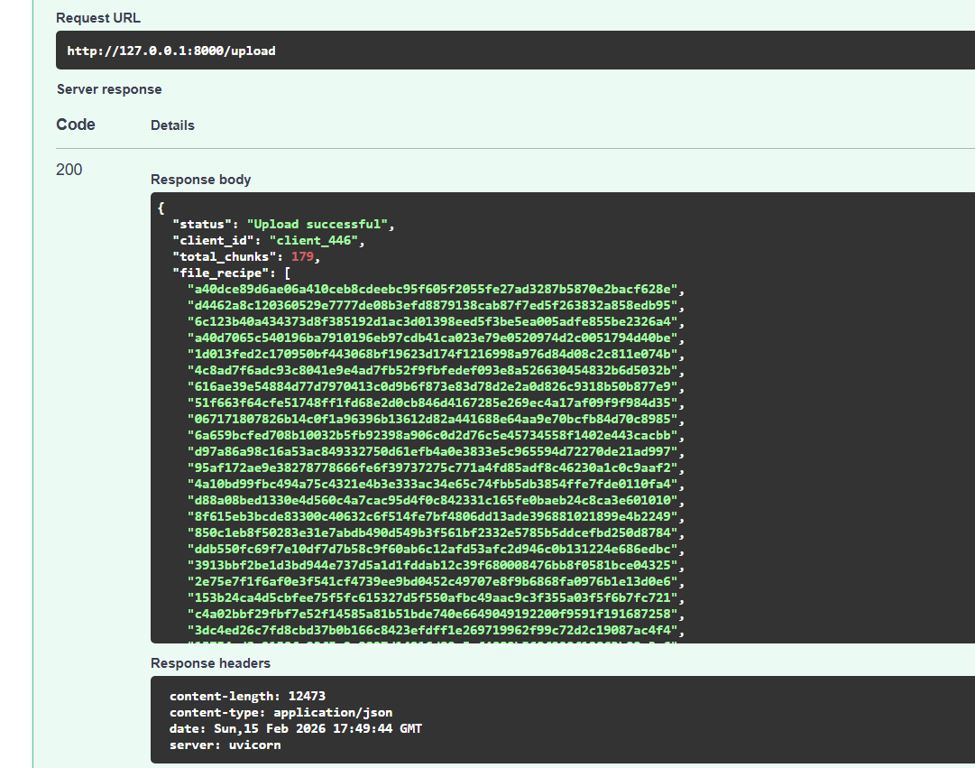
SAMPLE UI

Slide 18
EXPERIMENTAL SETUP
System Environment
Implemented in Python 3.12 on ASUS ROG Strix G513RC (Ryzen 7 6800H, 16 GB RAM, Windows 11). A cloud-simulated setup ensures realistic yet reproducible deployment.
FastAPI + Uvicorn (API layer)
NumPy, Pandas, Scikit-learn (ML & analysis)
Ristretto255 OPRF (libsodium/rbcl) for secure key derivation
Redis (deduplication index & control state)
AWS LocalStack (S3 simulation)
pytest: 46 tests across crypto, behavioural, and integration layers
Cloud & Storage Configuration
S3 simulated via LocalStack; backend abstraction supports S3, MinIO, and local storage
2200-window dataset (1400 benign, 800 attack: hash probing, ownership fraud, DoS)
Chunks stored using HMAC-based locators instead of raw SHA-256
Redis for low-latency state; SQLite for telemetry & feature extraction
Ristretto255 OPRF overhead: ~0.646 ms per chunk

Slide 19
DATASET PREPARATION
Two complementary data categories: prototype-generated operational measurements and a structured behavioural evaluation dataset:
Prototype measurements: deduplication outcomes, storage reduction, lookup latency, encryption/OPRF overhead, throughput, and adaptive PoW challenge statistics
Behavioural evaluation dataset: 2200-window simulated stress-test using same 12-feature schema as live telemetry pipeline
Benign windows: 1400 (63.6%) calibrated against 347 Azure Functions trace windows (Jan 2021). Attack windows: 800 (36.4%) — rule-generated synthetic traces; explicitly labelled as rule-derived not real attacker traces
Dataset composition (2200 total windows):
Normal (trace-aligned synthetic benign): 1400 (63.6%)
Ownership Fraud: 260 (11.8%)
Hash Probing: 270 (12.3%)
Deduplication DoS: 270 (12.3%). Total Anomalies: 800 (36.4%). 70/30 stratified train-test split used for supervised evaluation.

Slide 20
RESULTS AND DISCUSSION
Comparison with base-paper
Design Point | REFA (Wu et al., 2024) | Proposed
Token generation | Blind GDH + external key server | HMAC-SHA256, server-local K_server
PoW difficulty | Static (fixed challenge length) | 3-input adaptive function
Runtime detection | None | Supervised RF (PR-AUC 0.9686, F1 0.8990) + Cold-start OCSVM (PR-AUC 0.9191, F1 0.8134)
Key derivation | External key server manages keys | Ristretto255 OPRF blind-evaluate-unblind + HKDF-SHA256 per-chunk derivation (~0.646 ms overhead)
Policy enforcement | Static rate limits | Risk-score-driven ALLOW/RATE_LIMIT/BLOCK
Side-Channel Resistance | Partial | Yes (HMAC token opacity + OPRF + adaptive PoW)

Slide 21
RESULTS
Adaptive PoW Results
Model Comparison Table
Metric | Value
Static Baseline Proof Length | 32
Adaptive Mean (All Users) | 71.85
Adaptive Mean (Normal Users) | 49.58
Adaptive Mean (Anomalous Users) | 110.82
Metric | Supervised | Cold-Start OCSVM
PR-AUC | 0.9686 | 0.9191
F1 (Binary) | 0.8990 | 0.8134
Precision | 0.8898 | 0.7043
Recall | 0.9083 | 0.9625

Slide 22
DEDUPLICATION PERFORMANCE RESULTS
Storage and Throughput Metrics
Per-Operation Latency Breakdown
Operation | Value
Storage Reduction Ratio (SRR) | 65% – 80%
Index Lookup Complexity | O(1) — Redis hash map
System Throughput | 50,000 chunks/second
Storage Backend | AWS S3 / MinIO / Filesystem
Metric | Latency (ms) | Contribution
HMAC-SHA256 Token | < 0.02 ms | Security layer
Redis Index Lookup | < 0.50 ms | Dedup engine
AES-256-GCM Encrypt | < 0.10 ms | Encryption layer
PoW Verify | 2.5 ms | Security gate

Slide 23
COMPARATIVE ANALYSIS
Per-Class F1-Scores (Supervised RF)
Supervised vs. Unsupervised - Full Comparison
Metric | Value
Normal | 1.0000
Hash Probing | 0.8810
Ownership Fraud | 0.7763
Dedup DoS | 0.9048
Metric | Supervised (RF) | Cold-Start OCSVM
PR-AUC | 0.9686 | 0.9191
F1 (Binary) | 0.8990 | 0.8134
Precision | 0.8898 | 0.7043
Recall | 0.9083 | 0.9625

Slide 24


EVALUATION METRICS
DEDUPLICATION PERFORMANCE METRICS
Storage Reduction Ratio:
Measures physical vs. logical storage; SRR = 1 − (Physical Size / Logical Size). Achieved 65%–80% across workloads; cross-user dedup confirmed with 0 new entries on 2nd upload.
Higher values indicate better deduplication efficiency.
Deduplication Ratio:
Indicates the level of redundancy in uploaded data.
Synthetic Zipf workload (1000 chunks): 91.6% savings
REFA envelope overhead:
~3.9% (4 KB), ~2.0% (8 KB), ~1.0% (16 KB)
FastCDC: ~4 KB avg chunk, ~50,000 chunks/sec throughput

Slide 25


EVALUATION METRICS
Verification Success Rate
Measures correctness for legitimate users; adaptive PoW imposes mean challenge length of 49.58 bytes on normal users vs 110.82 bytes on anomalous users - 54.93% overhead vs static baseline.
Fraud Detection Rate Measures ability to prevent unauthorized ownership claims.
Achieved: Ownership Fraud Supervised F1=0.7671 (59/78 detected); Multiclass Macro-F1=0.8924.
Adaptive PoW: attacker success reduced from 0.8647 to 0.4713 (45.49% relative reduction under fixed-budget solver model).
Supervised FP=27; OCSVM cold-start FP=97 (high recall trade-off: detects 231/240 attack windows).

Slide 26

EVALUATION METRICS
For sequence-based detection:
Sequence Detection Rate
Used to evaluate stealth and slow-rate attack detection.
Achieved:
12-feature vectors (frequency x4, hash x4, temporal x4, user x2). HMAC 0.014ms, Redis 0.5ms, AES 0.082ms, PoW 2.5ms, total 3.2ms at 50K chunks/sec.
System Overhead Metrics
To ensure security does not degrade performance:
Logging Overhead (ms per request)
Feature Extraction Time (ms per client)
Model Inference Time (ms per prediction)
PoW Challenge Latency (ms)

Slide 27
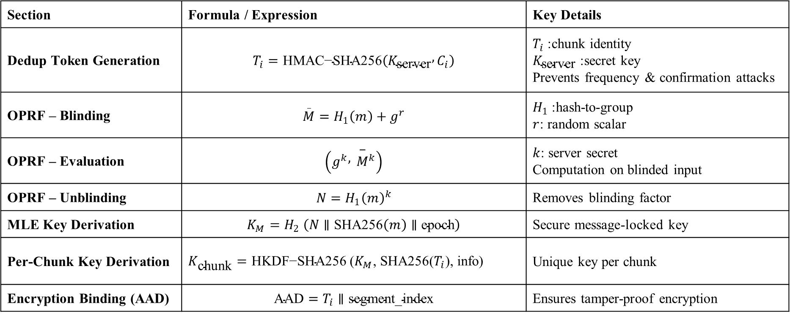
FORMULAS- CRYPTOGRAPHIC PATH
Section | Formula / Expression | Key Details
Dedup Token Generation | $$T_{i}=\text{HMAC}\text{−}\text{SHA}\text{256}\left(K_{\text{server}} , C_{i}\right)$$ | $T_{i}$: chunk identity $K_{\text{server}}$: secret key Prevents frequency & confirmation attacks
OPRF – Blinding | $$\overset{_}{M}=H_{1}\left(m\right)+g^{r}$$ | $H_{1}$: hash-to-group $r$: random scalar
OPRF – Evaluation | $$\left(g^{k} , {\overset{−}{M}}^{k}\right)$$ | $k$: server secret Computation on blinded input
OPRF – Unblinding | $$N=H_{1}{\left(m\right)}^{k}$$ | Removes blinding factor
MLE Key Derivation | $$K_{M}=H_{2} \left(N∥\text{SHA}\text{256}\left(m\right)∥\text{epoch}\right)$$ | Secure message-locked key
Per-Chunk Key Derivation | $K_{\text{chunk}}=\text{HKDF}\text{−}\text{SH}\text{A}\text{256 }\text{(}K_{M}$, SHA256($T_{i}$), info) | Unique key per chunk
Encryption Binding (AAD) | $$\text{AAD}=T_{i}∥\text{segment}\text{_}\text{index}$$ | Ensures tamper-proof encryption

Slide 28
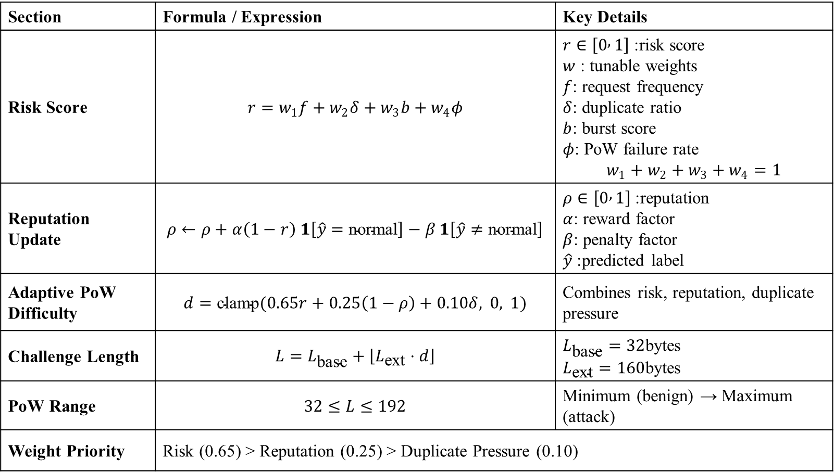
FORMULAS-RISK, REPUTATION & POW
Section | Formula / Expression | Key Details
Risk Score | $$r=w_{1}f+w_{2}δ+w_{3}b+w_{4}φ$$ | $r∈\left[0 , 1\right]$: risk score $w$ : tunable weights $f$: request frequency $δ$: duplicate ratio $b$: burst score $φ$: PoW failure rate $$w_{1}+w_{2}+w_{3}+w_{4}=1$$
Reputation Update | $$ρ←ρ+α\left(1−r\right) 1\left[\hat{y}=\text{normal}\right]−β 1\left[\hat{y}≠\text{normal}\right]$$ | $ρ∈\left[0 , 1\right]$: reputation $α$: reward factor $β$: penalty factor $\hat{y}$: predicted label
Adaptive PoW Difficulty | $$d=\text{clamp}(0.65r+0.25\left(1−ρ\right)+0.10δ, 0, 1)$$ | Combines risk, reputation, duplicate pressure
Challenge Length | $$L=L_{\text{base}}+\left\lfloor L_{\text{ext}}⋅d\right\rfloor$$ | $L_{\text{base}}=32$bytes $L_{\text{ext}}=160$bytes
PoW Range | $$32≤L≤192$$ | Minimum (benign) → Maximum (attack)
Weight Priority | Risk (0.65) > Reputation (0.25) > Duplicate Pressure (0.10)

Slide 29
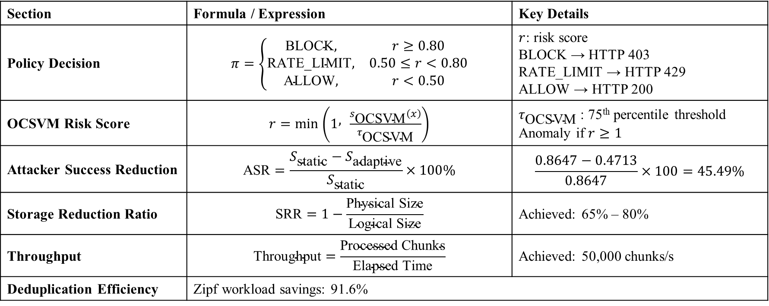
FORMULAS - POLICY, DETECTION & METRICS
Section | Formula / Expression | Key Details
Policy Decision | $$π=\left\{\begin{matrix}\text{BLOCK}, & r≥0.80 \\ \text{RATE}\text{_}\text{LIMIT}, & 0.50≤r<0.80 \\ \text{ALLOW}, & r<0.50\end{matrix}\right.$$ | $r$: risk score BLOCK → HTTP 403 RATE_LIMIT → HTTP 429 ALLOW → HTTP 200
OCSVM Risk Score | $r=min⁡$⁡$\left(1 , \frac{s_{\text{OCSVM}}\left(x\right)}{τ_{\text{OCSVM}}}\right)$ | $τ_{\text{OCSVM}}$: 75th percentile threshold Anomaly if $r≥1$
Attacker Success Reduction | $$\text{ASR}=\frac{S_{\text{static}}−S_{\text{adaptive}}}{S_{\text{static}}}×100\%$$ | $$\frac{0.8647−0.4713}{0.8647}×100=45.49\%$$
Storage Reduction Ratio | $$\text{SRR}=1−\frac{\text{Physical} \text{Size}}{\text{Logical} \text{Size}}$$ | Achieved: 65% – 80%
Throughput | $$\text{Throughput}=\frac{\text{Processed} \text{Chunks}}{\text{Elapsed} \text{Time}}$$ | Achieved: 50,000 chunks/s
Deduplication Efficiency | Zipf workload savings: 91.6%

Slide 30
Results - Supervised Detection (Random Forest)
Category | Metric | Value
Performance | PR-AUC | 0.9686
 | F1-Score (Binary) | 0.8990
 | Precision | 0.8898
 | Recall | 0.9083
 | Multiclass Macro-F1 | 0.8924
Confusion Matrix | True Positives (TP) | 218
 | True Negatives (TN) | 393
 | False Positives (FP) | 27
 | False Negatives (FN) | 22
Per-Class F1 | Normal | 1.0000
 | Hash Probing | 0.8810
 | Ownership Fraud | 0.7763
 | Deduplication DoS | 0.9048
Training Details | Dataset Size | 2200
 | Benign / Attack | 1400 / 800
 | Train Split | 70%
 | Label Type | Rule-based

Slide 31
Results – Unsupervised Detection (OCSVM)
Category | Metric | Value
Performance | PR-AUC | 0.9191
 | F1-Score | 0.8134
 | Precision | 0.7043
 | Recall | 0.9625
Confusion Matrix | True Positives (TP) | 231
 | True Negatives (TN) | 323
 | False Positives (FP) | 97
 | False Negatives (FN) | 9
Model Details | Training Data | Only Benign
 | Threshold | 75th percentile
 | Detection Capability | 231 / 240 attacks detected
Ablation Study | Z-score F1 | 0.1684
 | Supervised RF F1 | 0.8990
 | Hybrid Gate F1 | 0.8748

Slide 32
Results – Adaptive Proof-of-Ownership
Category | Metric | Value
PoW Length | Static Baseline | 32 bytes
 | Adaptive Mean (All Users) | 71.85 bytes
 | Normal Users | 49.58 bytes
 | Anomalous Users | 110.82 bytes
Security Impact | Attacker Success (Static) | 0.8647
 | Attacker Success (Adaptive) | 0.4713
 | Reduction | 45.49%
 | Benign Overhead | 54.93%
PoW Formula | Difficulty | d = clamp(0.65r + 0.25(1−ρ) + 0.10δ)
 | Challenge Length | 32 → 192 bytes
Weights | Risk / Reputation / Pressure | 0.65 / 0.25 / 0.10
Overhead | OPRF Cost | ~0.646 ms

Slide 33
Results – Per-Class F₁ and Module Comparison
Category | Metric / Method | Value
Per-Class F1 (RF) | Normal | 1.0000
 | Hash Probing | 0.8810
 | Ownership Fraud | 0.7763
 | Deduplication DoS | 0.9125
 | Macro-F1 | 0.8924
Model Comparison | Z-score (F1 / PR-AUC) | 0.168 / 0.4836
 | Supervised RF | 0.899 / 0.969
 | Hybrid Gate | 0.875 / 0.8386
 | Cold-start (OCSVM) | 0.813 / 0.919
Trace Alignment | τ_avg (Trace / Synth) | 4.917 / 5.758
 | Wasserstein Distance | 0.841
 | n_chunks (Trace / Synth) | 151.8 / 152.0
 | KS Test | p = 1.00

Slide 34
Results – Deduplication and Storage Performance
Category | Metric | Value
Storage & Throughput | Storage Reduction Ratio (SRR) | 65% – 80%
 | HMAC-SHA256 (per chunk) | < 0.02 ms
 | AES-256-GCM Encryption | < 0.10 ms
 | Redis Index Lookup | < 0.50 ms
 | Ristretto255 OPRF | ~0.646 ms
 | System Throughput | 50,000 chunks/s
Cross-User Deduplication | 1st Upload Entries | 16
 | 2nd Upload Entries | 0 (No duplication)
Deduplication Savings | Zipf Workload | 91.6%
 | Cross-user Measured | ~65%
 | Target High | ~80%
Overhead (REFA vs AES) | 4 KB Chunk | ~3.9%
 | 8 KB Chunk | ~2.0%
 | 16 KB Chunk | ~1.0%

Slide 35
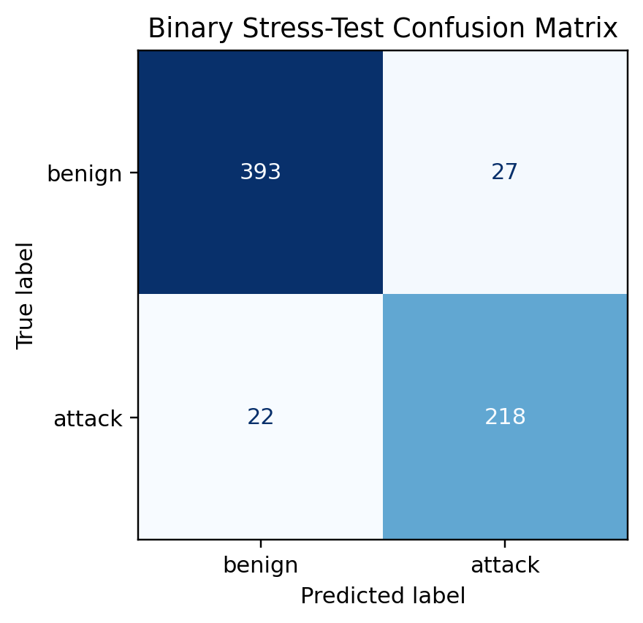
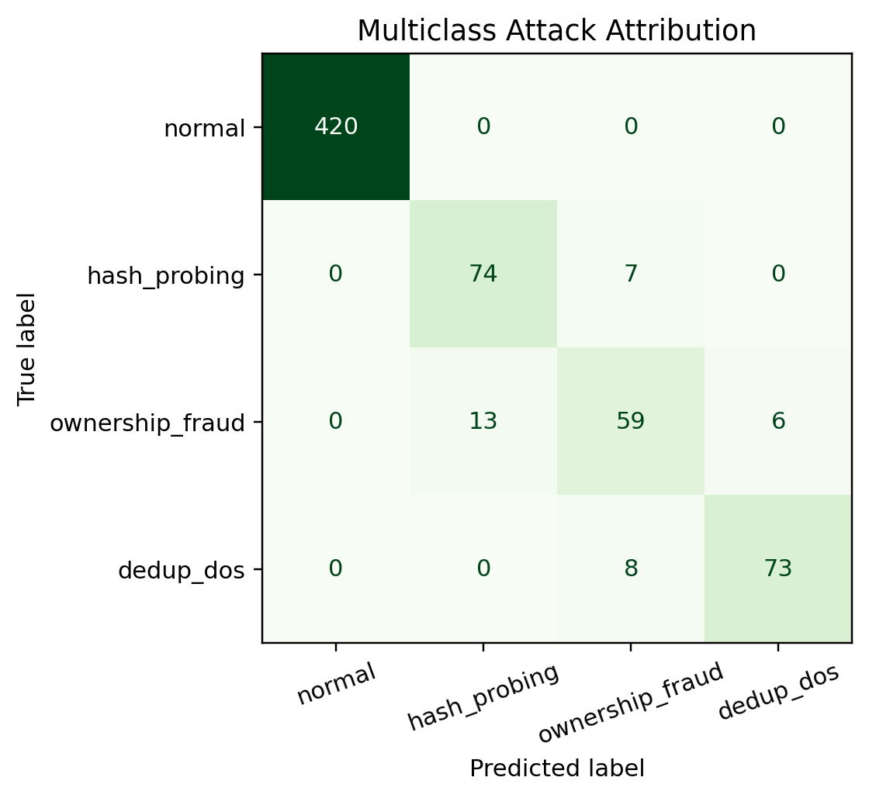
Results - Supervised Detection (Random Forest)

Slide 36
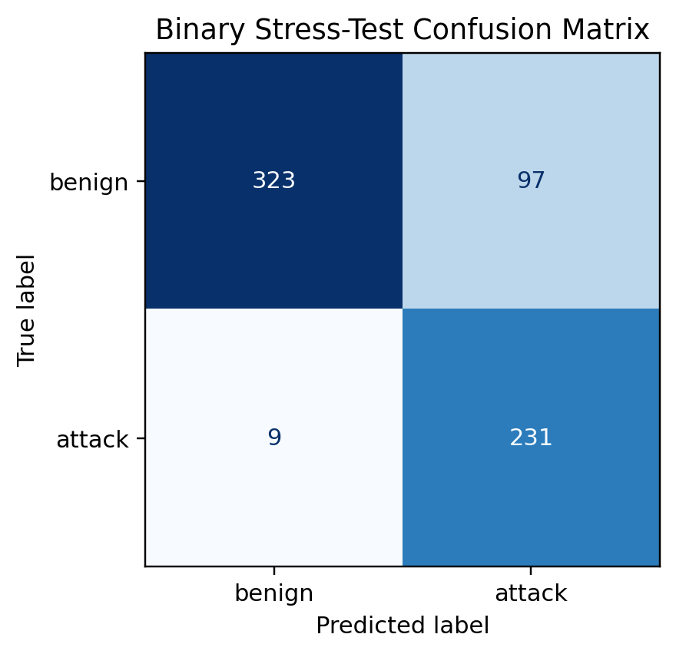
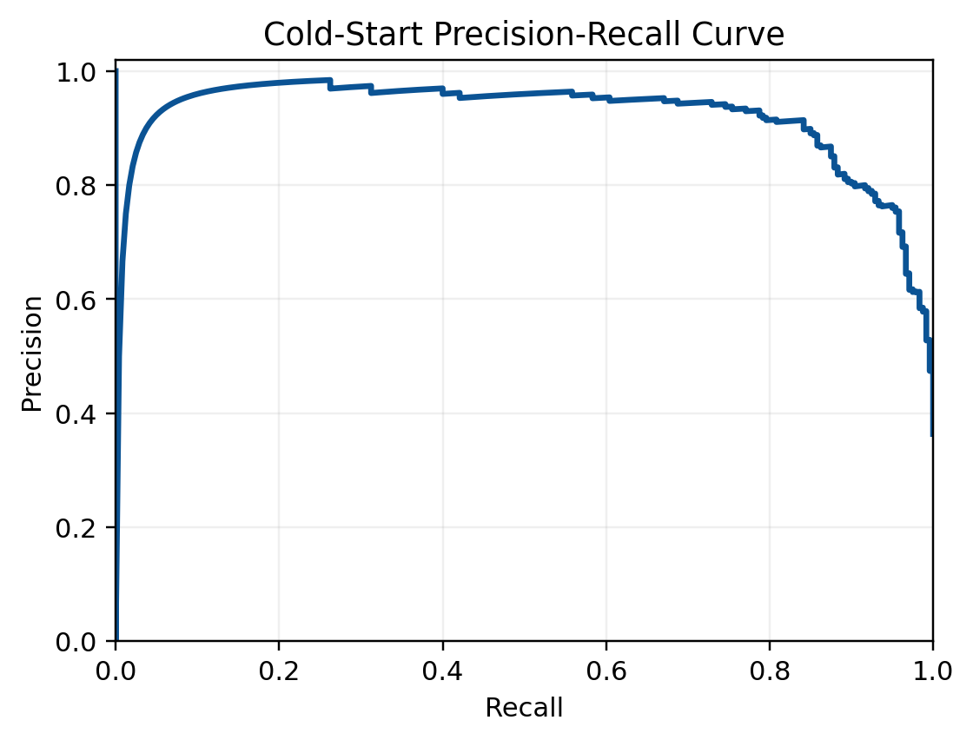
Results - Supervised Detection (Random Forest)

Slide 37
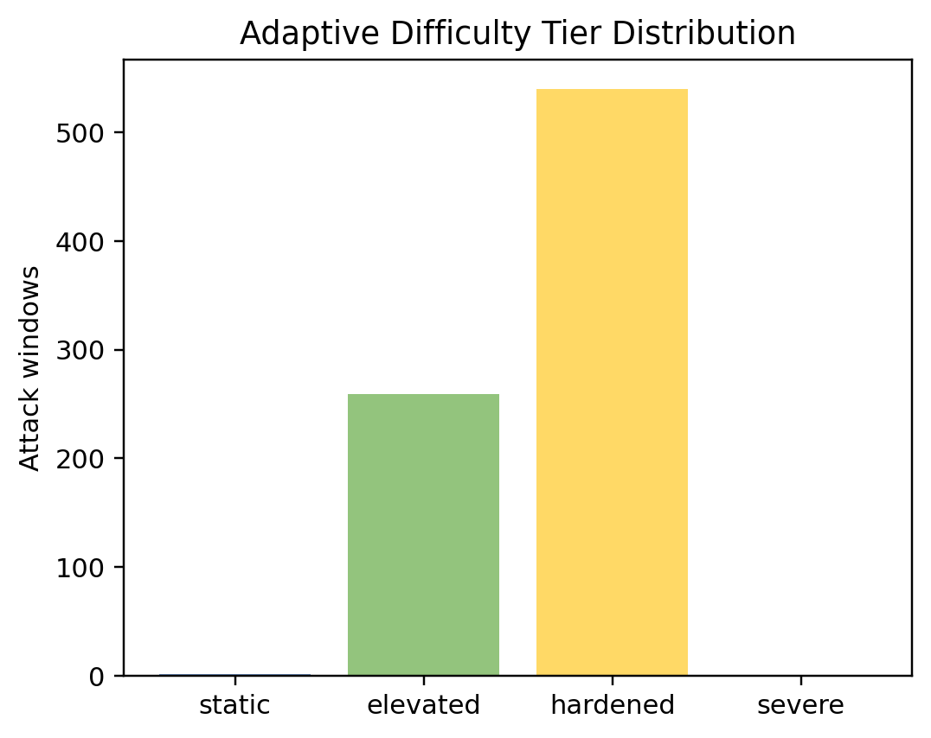
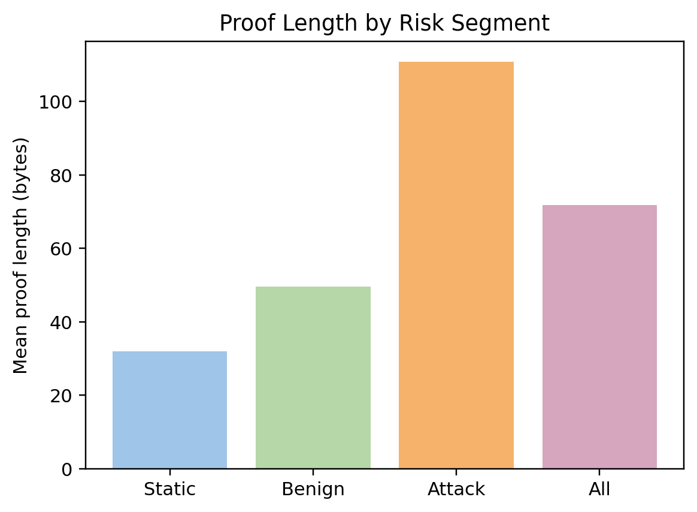
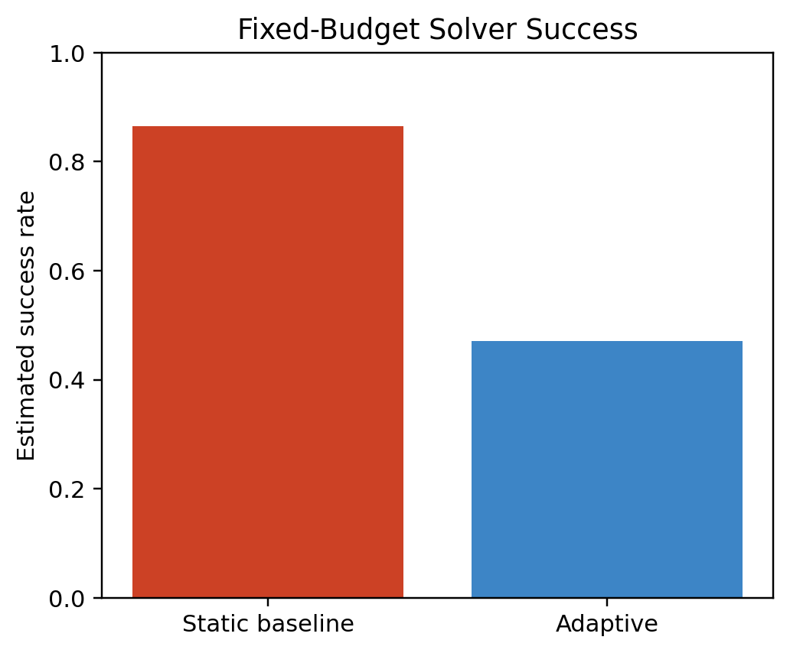
Results – Adaptive Proof-of-Ownership

Slide 38
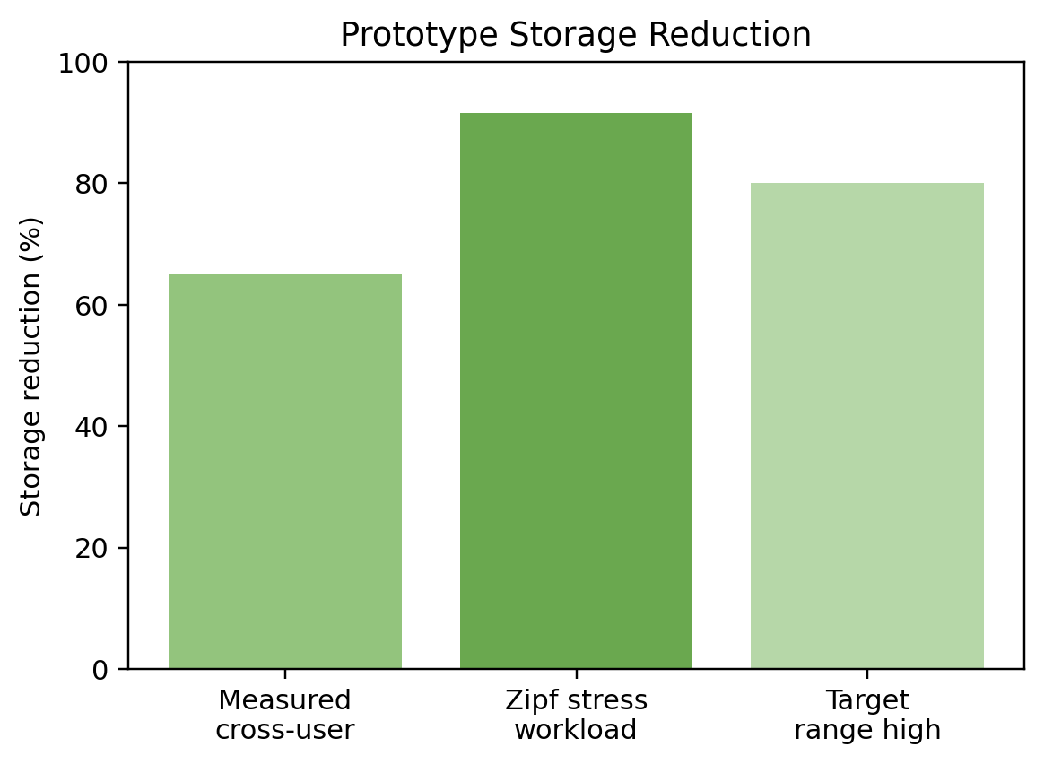
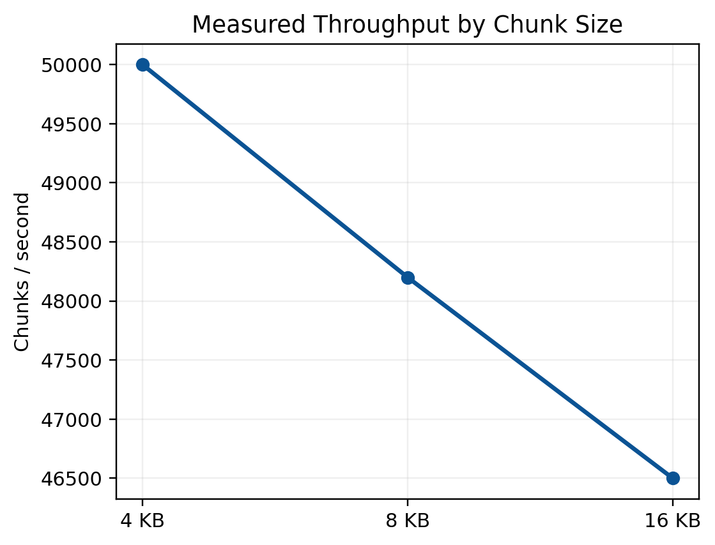
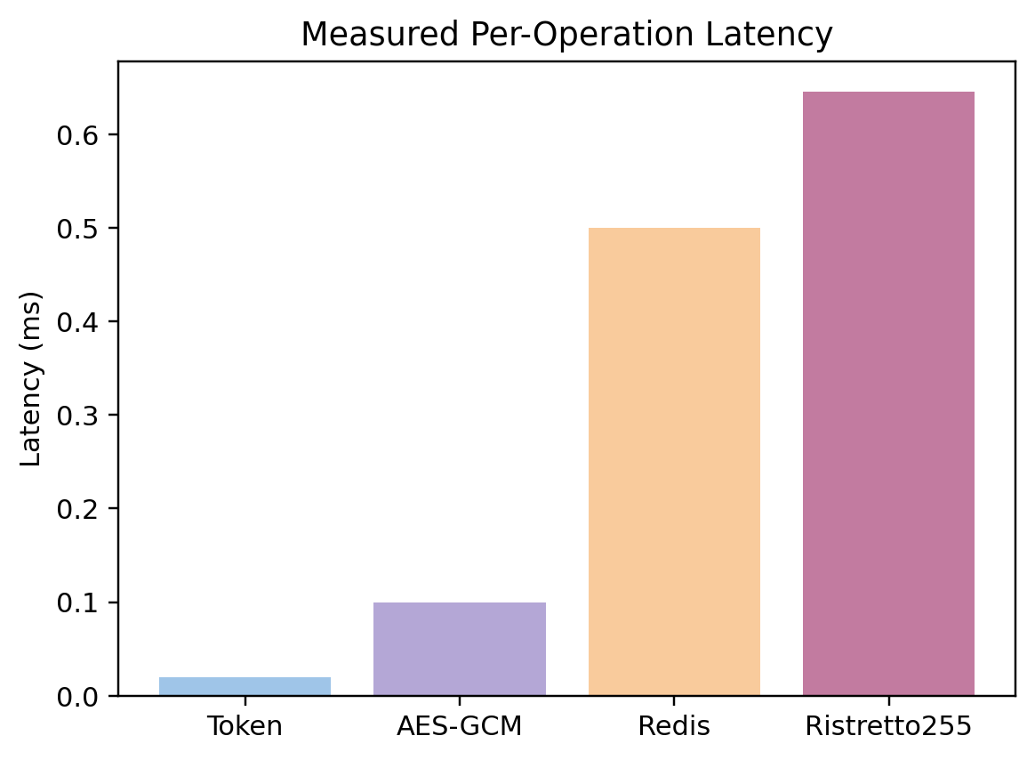
Results – Deduplication Performance

Slide 39
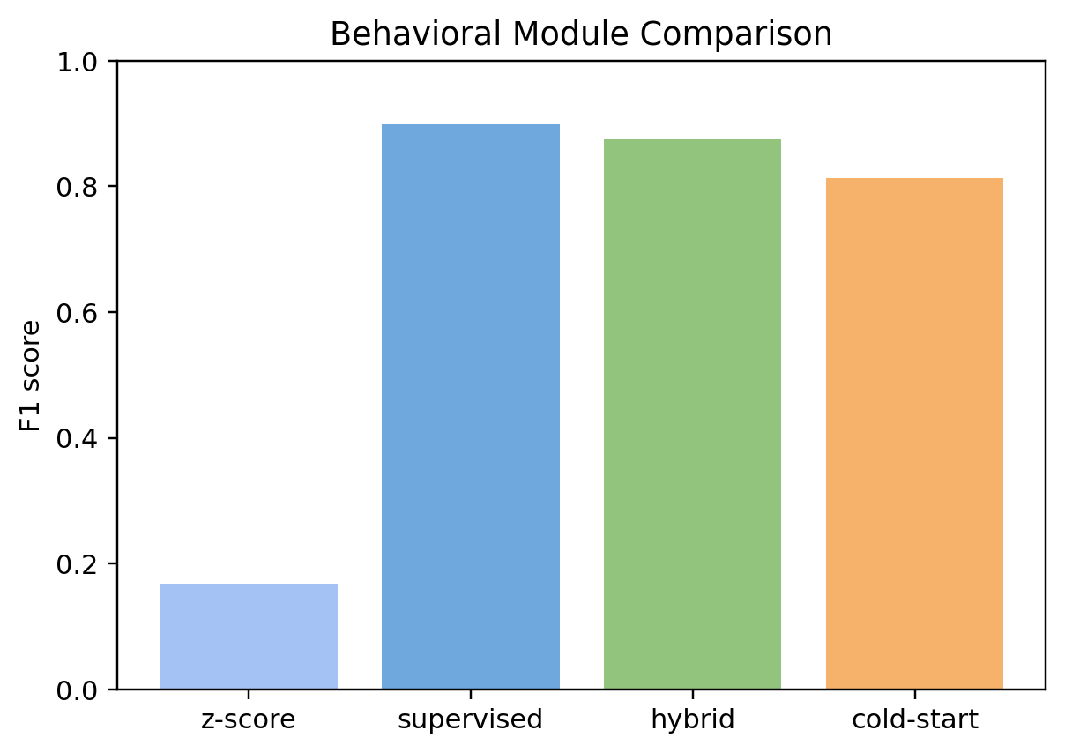
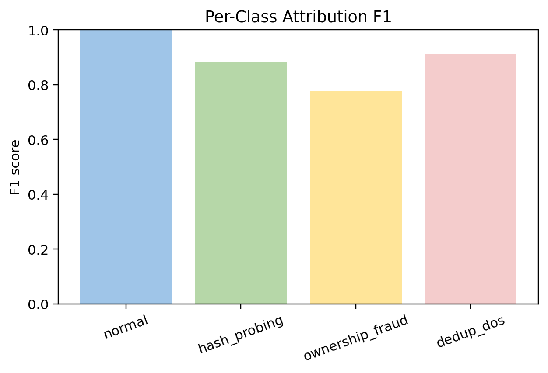
Results – Performance Comparison and Per-Class F₁ Score Analysis

Slide 40
TESTS & RESULTS
Cryptographic & Integration Test Results (46 Passing Tests)
Test Case | Focus Area | Result
Encrypt/Decrypt Roundtrip | Correctness | Passed
Wrong Context Decryption | Context Binding | Failed as Expected
OPRF Blind-Evaluate-Unblind | Key Derivation (CDH) | Passed
HMAC vs SHA-256 Difference | Token Security | Passed
AES-256-GCM AAD Binding | Tamper / Replay Protection | Passed
Note: Selected test cases shown above. Full suite: 46 passing tests across cryptographic, behavioural, cloud, and integration layers.

Slide 41
TESTS & RESULTS
Security & Frequency Test Results
Test Case | Focus Area | Result | Test Case
SHA-256 Reproducibility | Public Token | Vulnerable (Expected) | SHA-256 Reproducibility
HMAC Non-Reproducibility | Security | Passed | HMAC Non-Reproducibility
Wrong Key HMAC Failure | Secret Protection | Passed | Wrong Key HMAC Failure
Same Key Stability | Determinism | Passed | Same Key Stability
Same Chunk Across Users | Dedup Preservation | Passed | Same Chunk Across Users
Dedup Savings | Efficiency | Passed | Dedup Savings
Frequency Leakage (SHA-256) | Side-channel | Leakage Observed | Frequency Leakage (SHA-256)
Frequency Protection (HMAC) | Security | Passed | Frequency Protection (HMAC)
Confirmation Attack (SHA-256) | Vulnerability | Attack Possible | Confirmation Attack (SHA-256)
HMAC Blocks Attack | Security | Passed | HMAC Blocks Attack
HMAC Performance | Overhead | < 1 ms | HMAC Performance

Slide 42
TESTS & RESULTS
Behavioural & ML Test Results (2200-Window Stress-Test Dataset)
Test Case | Scenario | System Decision | Result
Hash Probing Detected | Attack | RATE_LIMIT | Passed
Normal Client | Legitimate | ALLOW | Passed
Adaptive PoW Increase | Suspicious | Harder Challenge | Passed
Dedup DoS Attack | Malicious | BLOCK | Passed
High Duplicate Only | Edge Case | Not Flagged | Passed
Ownership Fraud | Attack | RATE_LIMIT / BLOCK | Passed
Legitimate Retries | Normal | Allowed | Passed
Full Pipeline Attack | End-to-End | Detected | Passed
Full Pipeline Normal | End-to-End | Allowed | Passed
Static PoW Limitation | REFA Gap | Static: 0.8647, Adaptive: 0.4713 (45.49% reduction) | Verified
No Behaviour Detection (REFA) | Baseline Weakness | Missed Attack | Verified

Slide 43
TESTS & RESULTS
Key Performance & Security Metrics
Metric | Observed Value | Interpretation
SRR (Storage Reduction Ratio) | 65%–80% | Dedup preserved under secret-assisted scheme
System Throughput | 50,000 chunks/second | O(1) Redis index lookup
Supervised PR-AUC / F1 | 0.9686 / 0.8990 | Strong binary and multiclass performance
Cold-Start (OCSVM) PR-AUC / F1 | 0.9191 / 0.8134 | High recall early-warning screening
Adaptive PoW Attacker Success Reduction | 45.49% reduction (0.8647 → 0.4713) | Anomalous users get 2x longer challenges
Ristretto255 OPRF Key Derivation Overhead | ~0.646 ms per chunk | Concentrated in key path, not bulk encryption

Slide 44
REFERENCES
C. Gan, Y. Li, H. Chen, X. Lu, and L. Chen, “Coupling secret sharing with decentralised server-aided encryption in encrypted deduplication,” Applied Sciences, vol. 15, no. 3.
Y. Gao, L. Chen, J. Han, S. Yu, and H. Fang, “Similarity-based secure deduplication for IIoT cloud management system,” IEEE Transactions on Dependable and Secure Computing, vol. 21, no. 4, pp. 2242–2256, 2024.
A. Goel and C. Prabha, “Leveraging data deduplication approaches in cloud storage: A succinct review,” Procedia Computer Science, vol. 259, pp. 1640–1651, 2025.
H. Guan, L. Yu, L. Zhou, L. Xiong, K. Chowdhury, L. Xie, X. Xiao, and J. Zou, “Privacy and accuracy-aware AI/ML model deduplication,” arXiv preprint, 2025.
G. Ha, C. Jia, Y. Chen, H. Chen, and M. Li, “A secure client-side deduplication scheme based on updatable server-aided encryption,” IEEE Transactions on Cloud Computing, vol. 11, no. 4, pp. 3672–3684, 2023.
Z. Hua, Z. Wang, M. Song, Y. Zheng, G. Xu, and X. Jia, “Enabling secure auditing and deduplication in multi-replica cloud storage,” IEEE Transactions on Dependable and Secure Computing, vol. 22, no. 6, pp. 6653–6670, 2025.

Slide 45
REFERENCES
T. Jiang, J. Liu, Y. Zhou, and Y. Fang, “FuzzyDedup: Secure fuzzy deduplication for cloud storage,” IEEE Transactions on Dependable and Secure Computing, vol. 20, no. 3, pp. 2466–2483, 2023.
M. Lee and M. Seo, “Secure and efficient deduplication for cloud storage with dynamic ownership management,” Applied Sciences, vol. 13, no. 24.
J. Li, Z. Yang, Y. Ren, P. P. C. Lee, and X. Zhang, “Balancing storage efficiency and data confidentiality with tunable encrypted deduplication,” in Proc. ACM European Conf. Computer Systems (EuroSys), pp. 1–15, 2020.
X. Ma, W. Yang, Y. Zhu, and Z. Bai, “A secure and efficient data deduplication scheme with dynamic ownership management in cloud computing,” in Proc. IEEE Int. Performance, Computing, and Communications Conf. (IPCCC), pp. 194–201, 2022.
X. Peng, W. Shen, Y. Yang, and X. Zhang, “Secure deduplication and cloud storage auditing with efficient dynamic ownership management and data dynamics,” IEEE Transactions on Network and Service Management, vol. 22, no. 4, pp. 3463–3479, 2025.
P. Prajapati and P. Shah, “A review on secure data deduplication: Cloud storage security issue,” Journal of King Saud University-Computer and Information Sciences, vol. 34, no. 7, pp. 3996–4007, 2022.

Slide 46
REFERENCES
M. Song, Z. Hua, Y. Zheng, H. Huang, and X. Jia, “LSDedup: Layered secure deduplication for cloud storage,” IEEE Transactions on Computers, vol. 73, no. 2, pp. 422–435, 2024.
X. Tang, C. Guo, K.-K. R. Choo, X. Jiang, and Y. Liu, “A secure and lightweight cloud data deduplication scheme with efficient access control and key management,” Computer Communications, vol. 222, pp. 209–219, 2024.
T. Tarun, S. Goel, and C. Jadala, “ADD-QIA: An adaptive data deduplication framework based on quantum immune algorithm,” ResearchGate preprint, 2025.
X. Wu, H. Wang, Y. Yuan, and F. Li, “A lightweight encrypted deduplication scheme supporting backup,” Journal of Systems Architecture, vol. 138, pp. 102858, 2023.
X. Wu, J. Li, H. Wang, X. Liu, W. Wu, and F. Li, “A randomized encryption deduplication method against frequency attack,” Journal of Information Security and Applications, vol. 83, pp.103774, 2024.
B. Zhang, H. Cui, X. Liu, Y. Chen, Z. Yu, and B. Guo, “Decentralized and secure deduplication with dynamic ownership in MLaaS,” Journal of Information Security and Applications, vol. 76, pp. 103524, 2023.

Slide 47
REFERENCES
X. Zheng, W. Shen, Y. Su, and Y. Gao, “DIADD: Secure deduplication and efficient data integrity auditing with data dynamics for cloud storage,” IEEE Transactions on Network and Service Management, vol. 22, no. 1, pp. 299–316, 2025.
D. Harnik, B. Pinkas and A. Shulman-Peleg, "Side Channels in Cloud Services: Deduplication in Cloud Storage," in IEEE Security & Privacy, vol. 8, no. 6, pp. 40-47, Nov.-Dec. 2010.
C. Wang, Q. Wang, K. Ren and W. Lou, "Privacy-Preserving Public Auditing for Data Storage Security in Cloud Computing," 2010 Proceedings IEEE INFOCOM, pp. 1-9, 2010.
M. Zhou, R. Zhang, W. Xie, W. Qian and A. Zhou, "Security and Privacy in Cloud Computing: A Survey," 2010 Sixth International Conference on Semantics, Knowledge and Grids, pp. 105-112, 2010.
D. E. Denning, "An Intrusion-Detection Model," in IEEE Transactions on Software Engineering, vol. SE-13, no. 2, pp. 222-232, Feb. 1987.
Halevi, Shai & Harnik, Danny & Pinkas, Benny & Shulman-Peleg, Alexandra. (2011). “Proofs of ownership in remote storage systems”, Proceedings of the ACM Conference on Computer and Communications Security, 491-500.

Slide 48
REFERENCES
M. Song, Z. Hua, Y. Zheng, T. Xiang and X. Jia, "Enabling Transparent Deduplication and Auditing for Encrypted Data in Cloud," in IEEE Transactions on Dependable and Secure Computing, vol. 21, no. 4, pp. 3545-3561, July-Aug. 2024.
Ke, Zhaokang & Gong, Haoyu & Du, David. (2025). “PM-Dedup: Secure Deduplication with Partial Migration from Cloud to Edge Servers”, arXiv preprint, 2025.
Jingze Yu, Wenting Shen, Xi Zhang, “Cloud storage auditing and data sharing with data deduplication and private information protection for cloud-based EMR”, Computers & Security, Volume 144, 2024.
R. Du, L. Deng, J. Chen, K. He and M. Zheng, "Proofs of Ownership and Retrievability in Cloud Storage," 2014 IEEE 13th International Conference on Trust, Security and Privacy in Computing and Communications, 2014, pp. 328-335.
J. K. Periasamy, S. Prabhakar, A. Vanathi, and Y. Liu, “Enhancing cloud security and deduplication efficiency using cryptographic authentication mechanisms,” Scientific Reports, vol. 15, pp. 30112, 2025.
C. Wang, G. Xu, and Y. Zhang, “A CAE-based secure data deduplication method for cloud storage,” Scientific Reports, vol. 15, pp. 24605, 2025.

